Slide 1
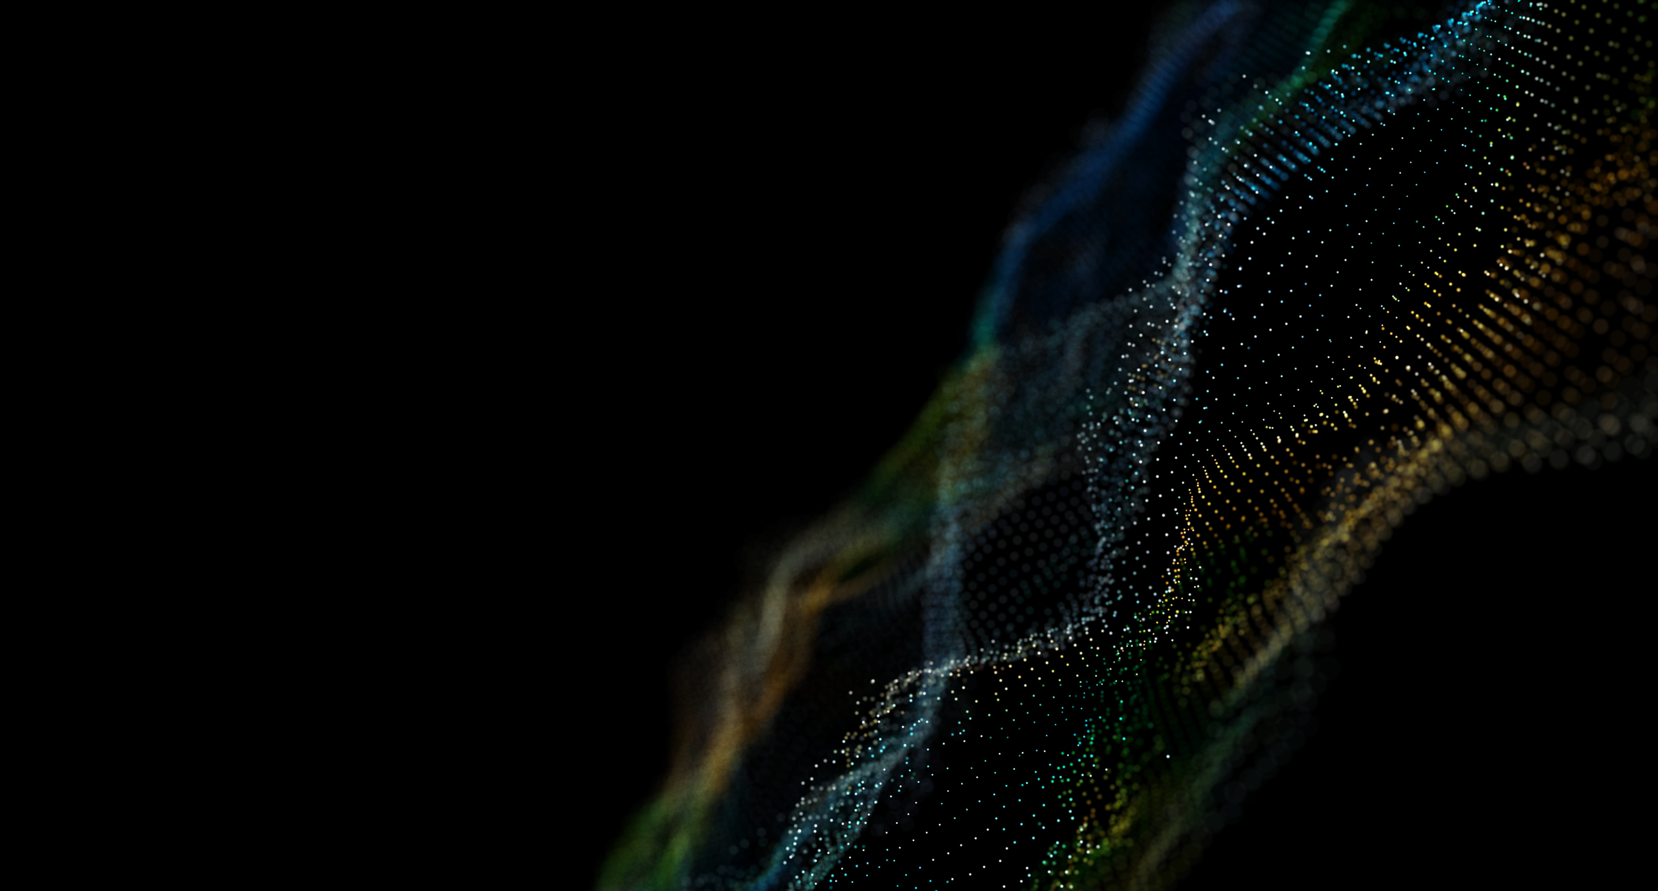
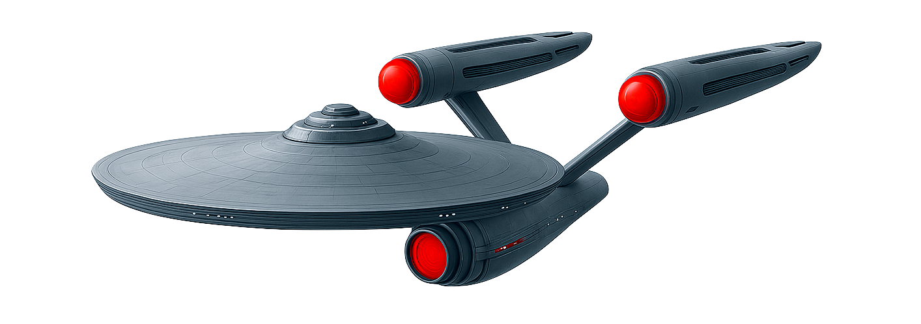
Space Aware
Women in Data – Datathon 2025
The Data Voyager
Notes:
Data: the great frontier. These are the analyses of The Data Voyager, in its four-week mission to explore open space datasets, uncover hidden patterns, empower women, democratize orbital analytics, and enhance space situational awareness — boldly going where data teams aspire to go.

Slide 2

Adriana M Q Weingart

Slide 3

Giovana Yukari Sandes

Slide 4

Giovanna Felix dos Santos

Slide 5

Fonts
Datasets
Arial
Edge of the Galaxy (fontspace.com)
USC Satellite Database (www.ucs.org/resources/satellite-database)
Space-Track.org (https://www.space-track.org/)
Images
Other Resources
PowerPoint design suggestions
LEOLABS – Low Earth Orbit Visualization
Copilot
iMovie
Music
Star Trek TOS Opening theme (YouTube)
Tools
MS PowerPoint
Python
Power BI
https://bit.ly/WiD2025Datathon-TheDataVoyager

Slide 6
Capitain’s log
Earthdate 2025.08.18.
The crew of The Data Voyager has been engaged in a four-week mission into the realm of orbital analytics.
Our objective: enhance space situational awareness through open data, empower women in data science, and chart new paths toward sustainability in Earth’s orbit.
Our journey has just begun.
Notes:
Captain’s Log, Earthdate 2025.08.18. The crew of The Data Voyager has been engaged in a four-week mission into the realm of orbital analytics.
Our objective: enhance space situational awareness through open data, empower women in data science, and chart new paths toward sustainability in Earth’s orbit.
Our journey has just begun.

Slide 7
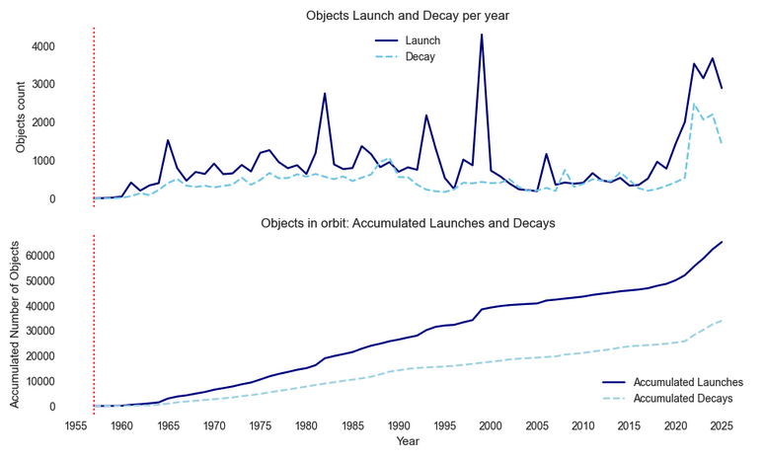
Sputnik 1 🚀
Start of Space Age
Notes:
Since 1957 when the Soviet Union launched the first satellite, Sputnik 1, into space marking the beginning of the Space Age, every decade, every year, more and more satelites are launched, as shown in this timeline with the top countries …

Slide 8
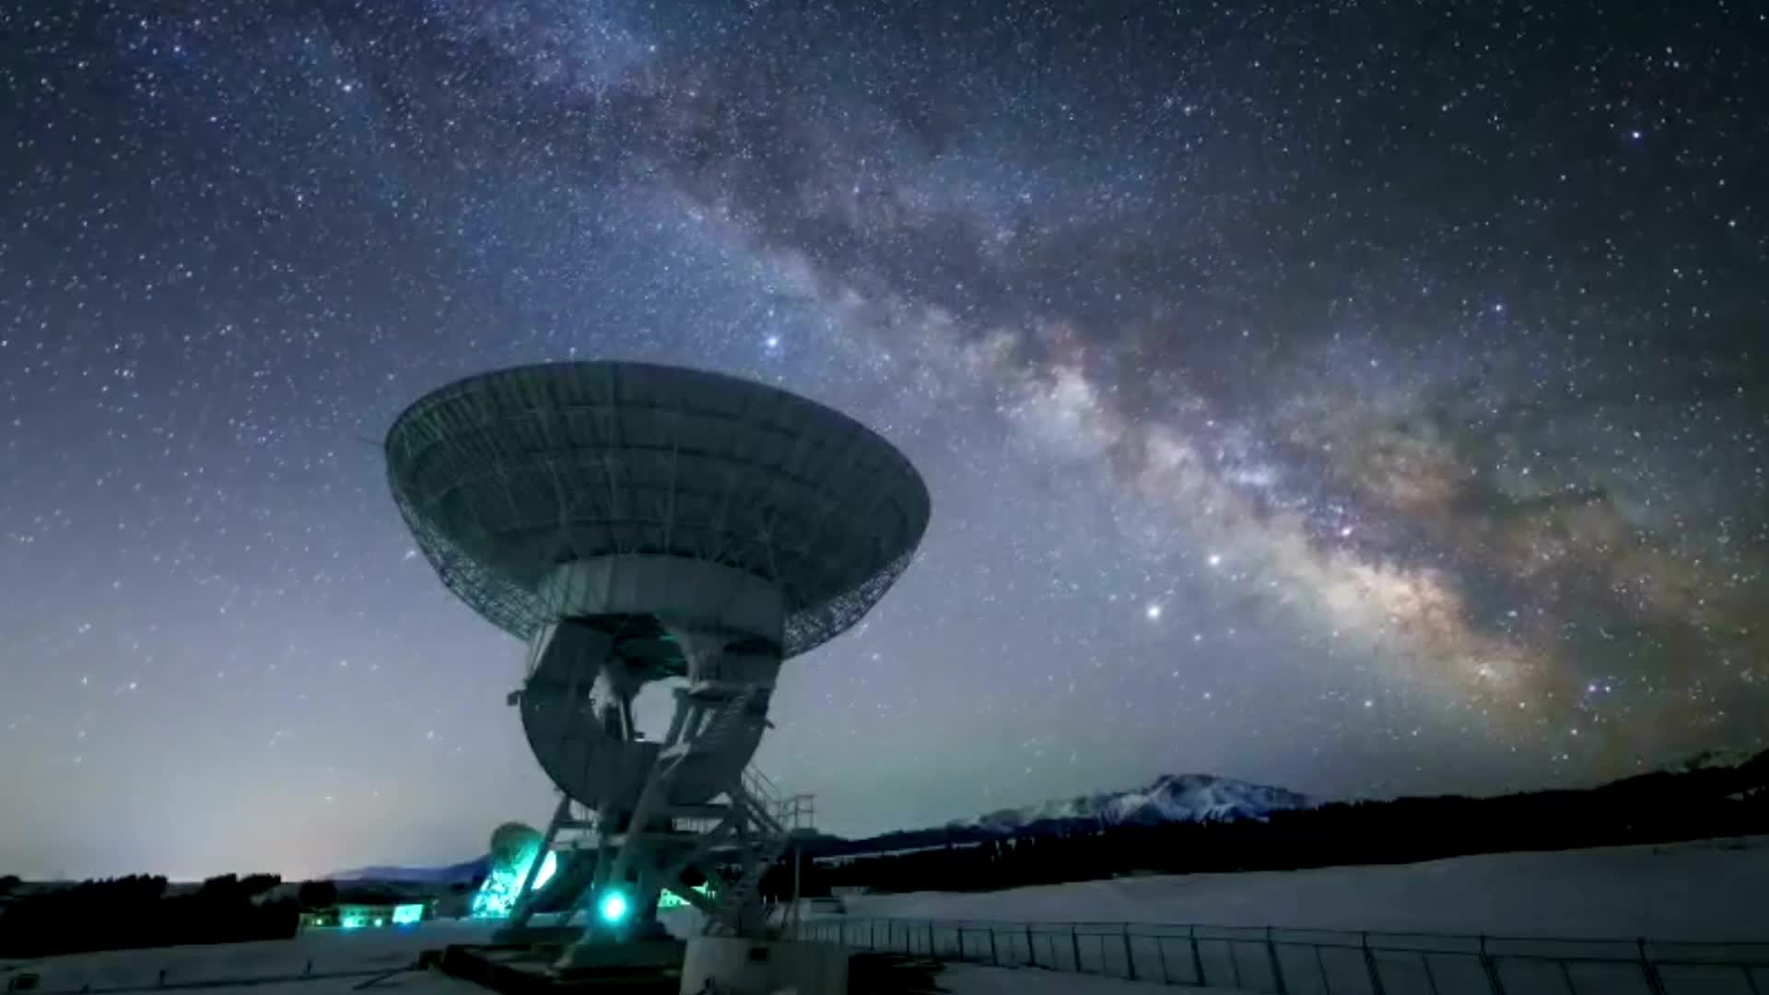
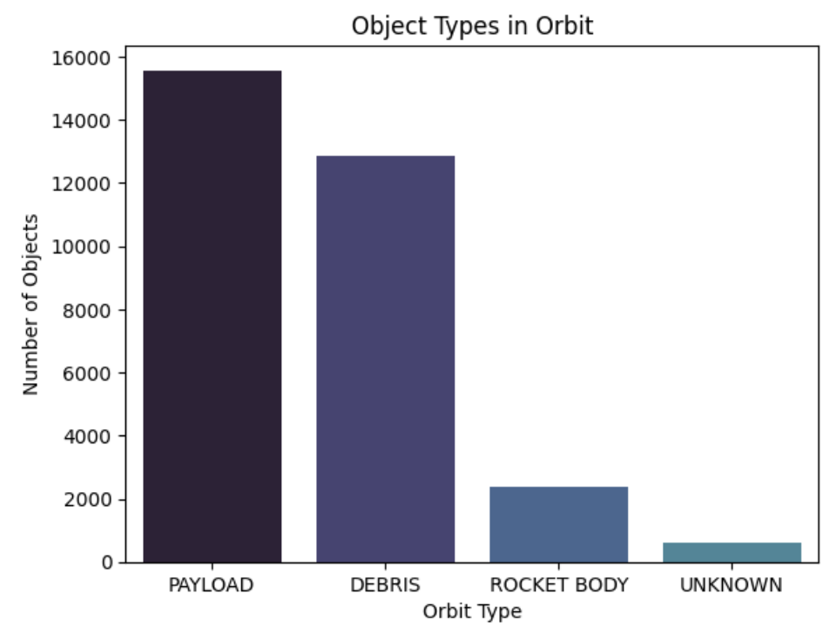
According to Space-Track.org, there are
more than 31K objects active in Earth’s orbit.
… and, out of this number, only 15,5K are Payloads. The others are Debris, Rocket Bodies or unknown objects.
Satellite: any object in orbit around the Earth (piece of debris and the Moon are satellites)
Payload: any object not classifed as rocket body or debris. Objects that carries out the mission’s specific task.
Notes:
According to Space-Track.org, there are more than 31.000 objects active in Earth’s orbit.
And out of this number, only 15.000 are payloads. Other objects are debris, rocket bodies or unkwnon objects.

Slide 9
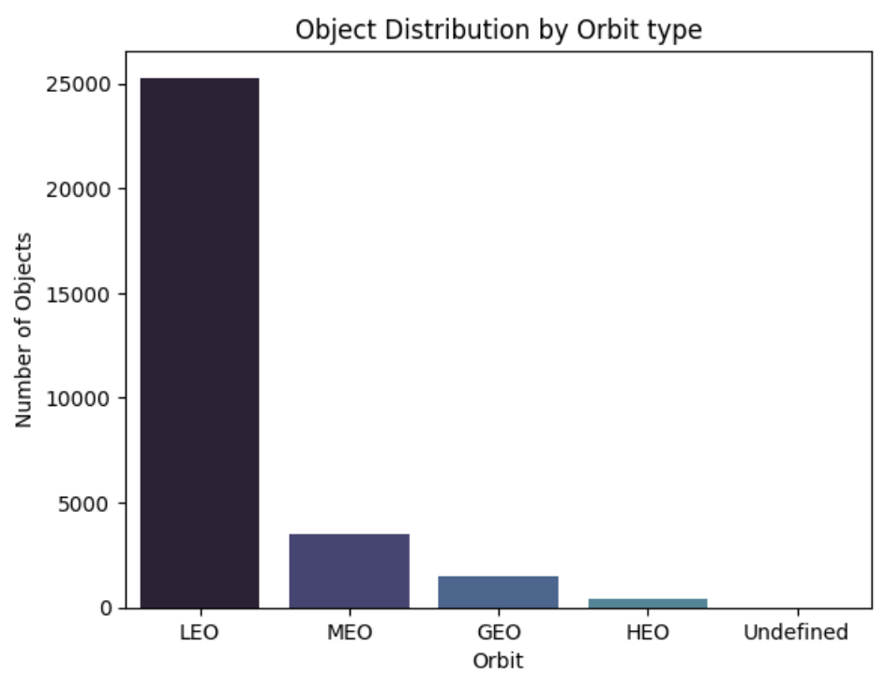


Orbits by Altitude
Orbit Type | Usual Altitude | Period | Characteristics
LEO Low Earth Orbit | 160 - 1.200km | about 90min | Widely used for observation and communication, and constallations like Starlink
MEO Medium Earth Orbit | 2.000-35.786km | 2h – 12h | Used for GPS and navigation
GEO Geostationary Orbit | about 35.786km | about 24h | Object appears to be “stationary” over a single point on Earth. Ideal for telecommunications and meteorology.
HEO Highly Elliptical Orbit | Perigee about 1000km Apogee till 39.000km | about 12h | Inclined elliptical orbit. Used for coverage of polar regions or specific communications
GEO
MEO
LEO
HEO
Moon
Lunar orbit (384.000km)
Notes:
About 25K objects are in the LEO orbit, which is the lowest orbit. This Low Earth Orbit is widely used for observation and communication. Constellations, like Starlink, are in this orbit.

Slide 10
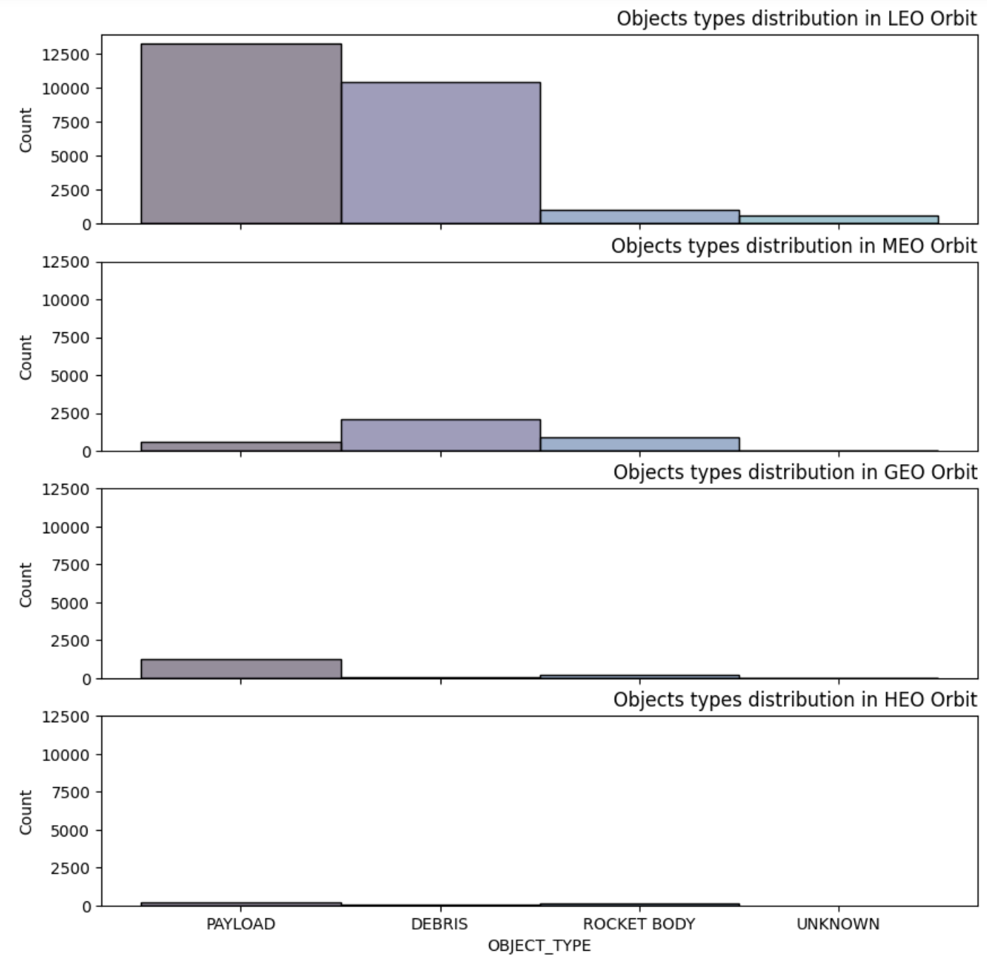
Amore than 40% Objects (+10K) in LEO are debris
while payloads are 13K objects
On the other hand, in MEO
almost 60% objects are debris.
Adding rocket bodies, this number goes to
84% non-payload objects in orbit.
Payloads are only 564 objects
In higher orbits (GEO and HEO),
the number of objects in smaller,
and number of non-payload objects are also smaller.
Notes:
Checking in details the objects in each orbit, we find that more that 50% of objects in LEO and MEO are debris. And this number increases if we consider the rocket bodies as well. Can we call them “space junk”?

Slide 11
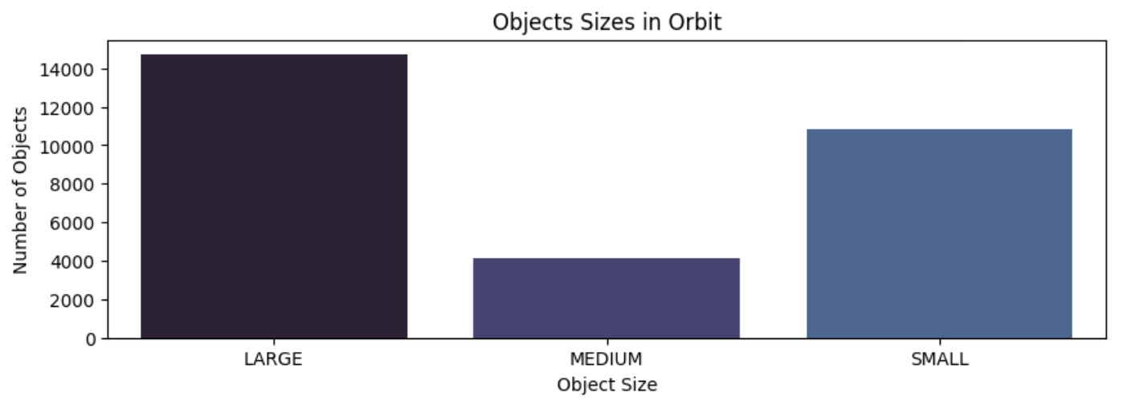
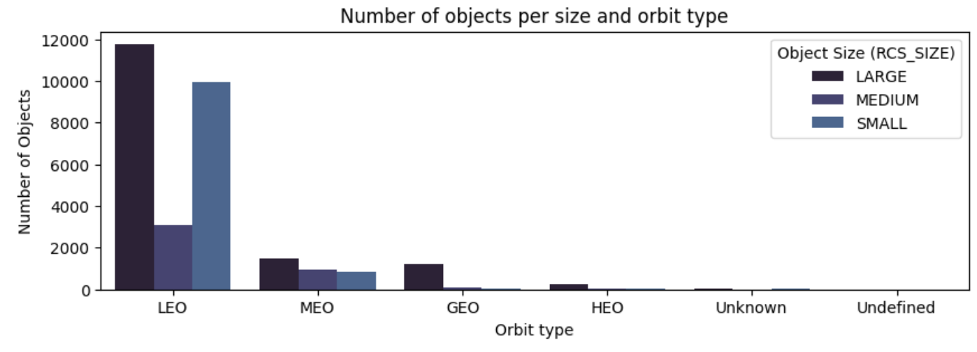
Object RCS matters…
… to evaluate radar signature of objects.
Why RCS is important
RCS (Radar Cross Section) measurements are essential for evaluating and minimizing the radar signature of objects where low observability is required.
A higher RCS means the object appears larger to radar systems, making it easier to detect and track). RCS measurements provide information that helps estimate the physical size and shape of objects.
In LEO, with about 25K objects in orbit (45% of these are debris and rocket bodies) , RCS helps:
Detection and tracking
Space debris management
Situational Awareness
Collision Risk Assessment
Notes:
And, it is not only about volume. It is also about their size and shapes. Radar Cross Section measurements allows us to evaluate their radar signature, and determine how visible it is (including size and shape), helping in detecting and tracking objects, managing debris, and in the collision risk assessment.

Slide 12
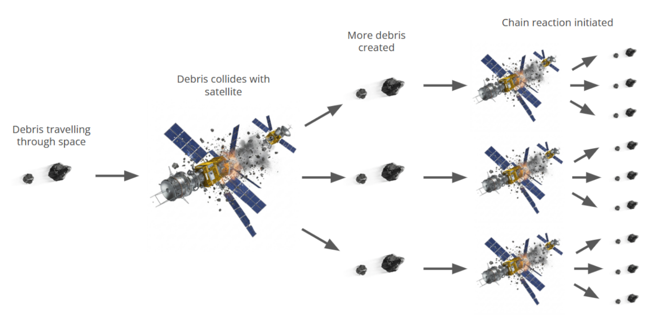
Kessler Syndrome
Theoretical scenario of “collisional cascading” in Earth’s orbit, where the density of space debris reaches a critical point, causing collisions that generate even more debris in a chain reaction of impacts: Kessler’s effect
Consequences:
Disruption of essential services (such as GPS, communication and Earth-observation)
Increased risk to human activity (such as future space missions and splaceflight activities).
Image source: amplyfi.com blog
Notes:
And here comes a big source of concern in the Space… Collision Risk Assessment.
Besides the concern for observability and paths among the objects for new space missions, there is a concern about the “Kessler Syndrome”
How it happens:
First, you have a high-density environment, with a substantial amount of spent rockets, payloads and other junk, like in LEO.
As these debris accumulates, it reaches a point of critical mass, where collisions become likely.
One collision creates more debris, increrasing the probability of further collisions, setting of a runaway chain reaction: the collisional cascading.
In the end, the resulting increase in debris makes it too dangerous to launch and operate new satellites or spacecraft, effectively “polluting” the orbit and making it unusable.
https://amplyfi.com/blog/understanding-the-space-debris-dilemma-the-kessler-syndrome/

Slide 13
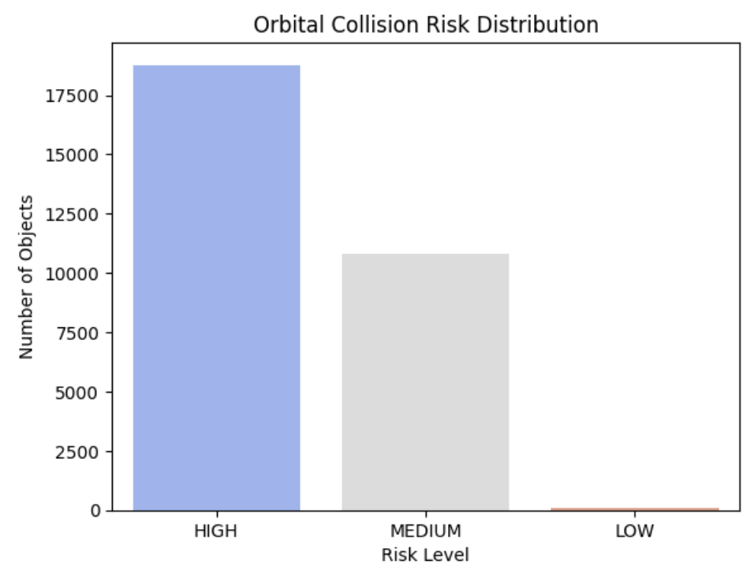
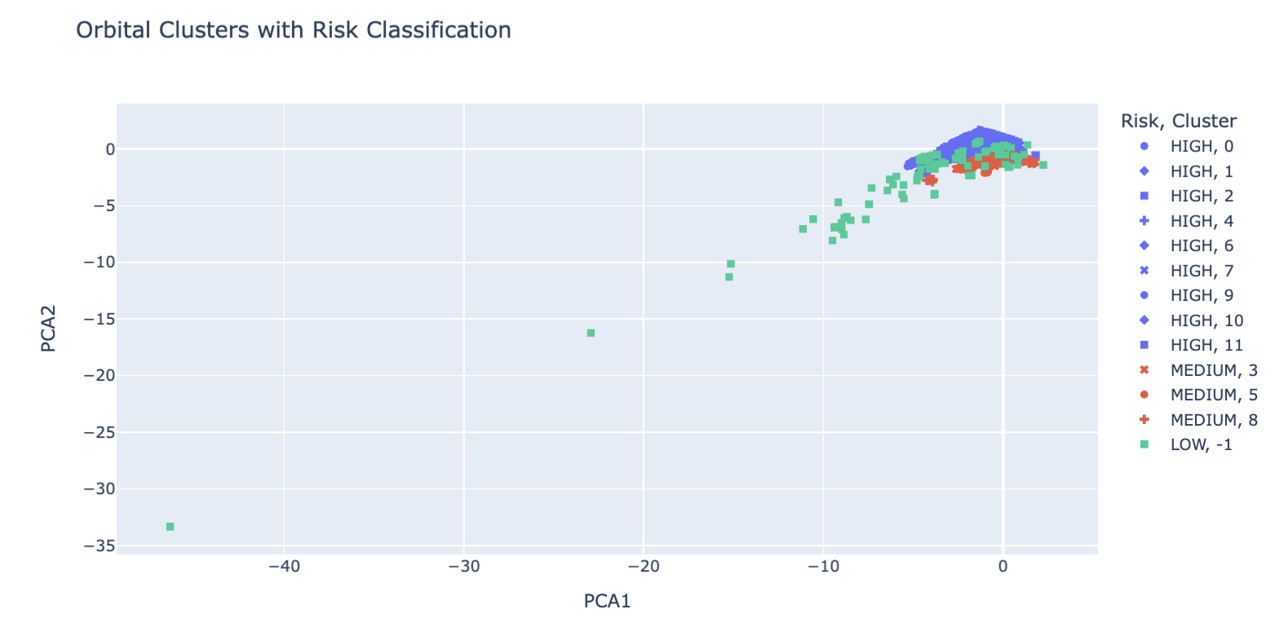
Orbital Collision Risk - Clustering
Methods: DBSCAN and PCA
Clusters based on
Apogee
Perigee
Inclination
RCS
 | HIGH | MEDIUM | LOW
LEO | 14870 | 9953 | 3
MEO | 2351 | 843 | 43
GEO | 1282 | 12 | 9
HEO | 255 | 10 | 59
Unknown | 0 | 0 | 0
Undefined | 10 | 5 | 0
Notes:
Building on the discussion of RCS values and the growing number of objects in orbit, we conducted a clustering analysis to identify regions of orbital space with high collision risk.
Using DBSCAN and PCA, we grouped active orbital objects based on their apogee, perigee, inclination, and RCS.
The results revealed 13 distinct orbital clusters, that were classified and grouped as high, medium and low risk. 17,500 active objects were classified as HIGH collision risk, based on proximity and size.
These findings reinforce the urgency of addressing orbital congestion, particularly in LEO, where the combination of high object count and large RCS values significantly increases the probability of cascading collisions - a scenario consistent with the Kessler Syndrome model.
Interpretação dos Clusters:
1 – Clusters densos = maior risco
Objetos agrupados em regiões próximas do gráfico indicam órbitas similares.
Se muitos objetos estão no mesmo cluster, há maior chance de colisão, especialmente se forem grandes (RCS_SIZE alto).
2 – Outliers (cluster = -1 no DBSCAN)
São objetos com órbitas muito difernetes dos demais.
Geralmente considerados baixo risco, pois estão isolados
3 – Clusters com objetos grandes
Se um cluster contém objetos com alto RCS_SIZE, o risco aumenta
Um objeto grande em uma região densa é mais perigoso que vários pequenos.

Slide 14
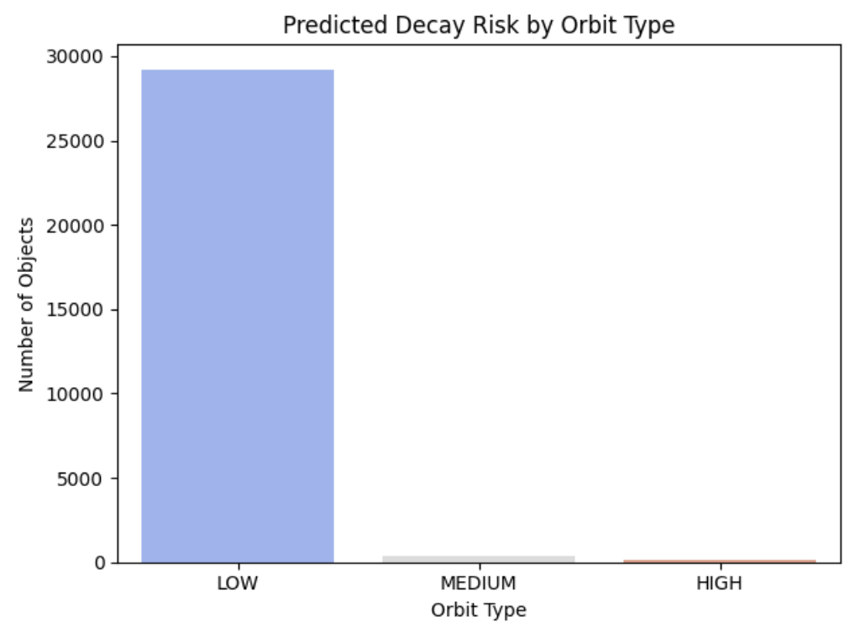
Predicting Orbital Decay Risk
As orbital congestion increases, predicting which objects are likely to decay becomes critical for risk mitigation and debris management.
Model:
Random Forest Classifier trained to predict decay based on:
Apogee, Perigee, Inclination, Period
RCS Size (quantified)
Launch Year
Target: Binary Classification (Decayed vs Active)
 | LOW | MEDIUM | HIGH
LEO | 24380 | 327 | 119
MEO | 3217 | 12 | 8
GEO | 1302 | 1 | 0
HEO | 322 | 1 | 1
Unknown | 0 | 0 | 0
Undefined | 7 | 5 | 3
The model identifies objects with high probability of atmospheric reentry, enabling proactive monitoring and prioritization.
Notes:
Using objects data and orbital parameters, we trained a predictive model to estimate the likelihood of decay.
Our model shows that the vast majority of active objects in orbit have a low probability of decay in the near term.
This highlights the long-term persistence of orbital assets and the limited natural decay in higher orbits.
While predictive modeling helps identify future decay candidates, it also reveals a critical limitation: most objects will remain in orbit for years or decades unless actively removed.

Slide 15
Mitigation Strategies
For Inactive and High-Risk Orbital Objects
Beyond predicting decay, it is important to address the growing population of inactive objects (including debris and rocket bodies) that pose long-term collision risks and additional concerns for space exploration and research.
Strategy | Description | Appliable to | Organizations / Contries working on these (or similar) strategies
Active Debris Removal (ADR) | Robotic missions to capture and remove large debris from orbit | Rocket Bodies Large Debris | Astroscale (Japan), ESA CAT-IOD Mission, NASA, CNES
Deorbit kits / Drag Sails | Devices that increase atmospheric drag to accelerate reentry | Small Payloads Rocket Bodies | ESA ADEO Sail, SWIFT Project (Portugal), NASA
Graveyard Orbits | Repositioning defunct satellites to safe, unused orbital zones | GEO Satellites | ESA, NASA, IADC Guidelines, UN COPUOS
Laser Nudging / Photon Pressure | Ground (or space) based lasers to gently alter debris trajectory | Small to medium Debris | NASA OTPS Study, CNES, Photonic Associates (USA)
International Coordination | Global guidelines and cooperative policies to prevent debris generation | All object types | IADC, UNOOSA, ESA, NASA, JAXA, ISRO, ROSCOSMOS
Notes:
While predictive models help identify active satellites likely to decay naturally, most objects — especially inactive ones like rocket bodies and debris — will remain in orbit for years unless actively removed. To address this challenge, global efforts are underway: from robotic debris removal and drag sails to international coordination under the IADC framework. The table outlines key mitigation strategies, their target object types, and leading organizations. Together, these initiatives mark a vital step toward sustainable and safer orbital operations.
While predictive modeling helps us identify which active satellites are likely to decay naturally, the reality is that most objects will remain in orbit for years (or even decades) unless we intervene.
This is especially true for inactive objects like rocket bodies and debris fragments, which no longer serve any function but continue to pose collision risks.
To address this growing challenge, several mitigation strategies are being developed and tested around the world. These range from robotic missions to actively remove large debris, to passive solutions like drag sails that accelerate reentry. International coordination also plays a key role, with agencies NASAworking under the IADC (Inter-Agency Space Debris Coordination Committee) framework to promote responsible orbital behavior.
This table summarizes the main approaches currently in use or under development, along with the types of objects they target and the organizations leading the charge. Together, these efforts represent a critical step toward sustainable space operations and long-term orbital safety.
https://www.unoosa.org/documents/pdf/copuos/stsc/2025/ListOfTechnicalPresentations/2_Tuesday4th/AM1_-_JAPAN_Item5_Global_implementation_of_active_debris_removal_Nobu_Okada_as_of_2_Feb.pdf
https://blogs.esa.int/cleanspace/2024/12/12/cat-iod-mission-pioneering-active-debris-removal-technologies/
https://spaceinsider.tech/2025/03/19/european-companies-win-e3-million-esa-contract-for-satellite-deorbiting-drag-sail-device-development/
https://ntrs.nasa.gov/api/citations/20240005687/downloads/2024%20-%20OTPS%20-%20Ground-Based%20Laser%20Debris%20TIM%20v3.pdf
https://orbitaldebris.jsc.nasa.gov/library/iadc-space-debris-guidelines-revision-2.pdf
https://iadc-home.org/

Slide 16
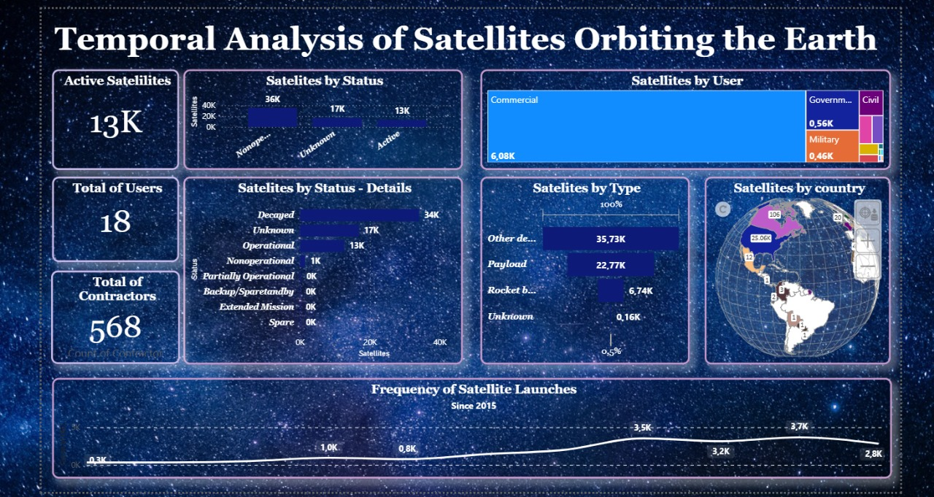
Notes:
To support ongoing monitoring and informed decision-making, our team developed a prototype dashboard that consolidates key data on objects in Earth orbit. The tool provides an overview of object status, distribution by country, and launch frequency over the past decade.
While still limited in scope, the dashboard serves as a foundational step toward operational awareness. It allows users to explore orbital populations, identify trends, and contextualize risk assessments derived from our predictive models. Future iterations will aim to integrate real-time tracking, decay probability alerts, and collision risk indicators.

Slide 17
Capitain’s log – Final Entry
Earthdate 2025.09.15.
The Data Voyager completes its mission, having charted the orbital landscape with passion and curiosity.
Over four weeks, the crew decoded the patterns of decay, mapped collision risks, and built a first prototype of a monitoring dashboard - a humble but promising tool for space traffic awareness.
Though our sensors detected low decay probability across most active objects, the real threat lies in the silent drift of inactive debris and rocket bodies.
The crew has proposed mitigation strategies, from robotic retrieval to photon nudging, and outlined future analyses to guide the next phase of orbital stewardship.
This voyage was more than data: it was collaboration, empowerment, and the pursuit of insight in the vastness of open space datasets.
The mission ends, but the journey continues. The stars await our next query.
Notes:
Capitain’s log – Final Entry
Earthdate 2025.09.15. The Data Voyager completes from its mission, having charted the orbital landscape with curiosity.
Over four weeks, the crew decoded the patterns of decay, mapped collision risks, and built a first prototype of a monitoring dashboard - a humble but promising tool for space traffic awareness.
Though our sensors detected low decay probability across most active objects, the real threat lies in the silent drift of inactive debris and rocket bodies. The crew has proposed mitigation strategies, from robotic retrieval to photon nudging, and outlined future analyses to guide the next phase of orbital stewardship.
This voyage was more than data: it was collaboration, empowerment, and the pursuit of insight in the vastness of open space datasets. The mission ends, but the journey continues. The stars await our next query.

Slide 18
The Data Voyager
Adriana M Q Weingart
Giovana Yukari Sandes
Giovanna Felix dos Santos
https://bit.ly/WiD2025Datathon-TheDataVoyager

